Slide 1



Operating System (203105203)
Prof. Umang panchal, Prof Atul Kumar Assistant Professor
Computer Engineering

Slide 2


CHAPTER-3
Inter-Process Communication

Slide 3
Topics
Critical Section
Race Conditions
Mutual Exclusion
Hardware Solution.
Strict Alternation.
Peterso’s Solution,
The Producer\Consumer Problem
Semaphores
Event Counters.
Monitors.
Classical IPC Problems: Readers & Writer Problem.
Dinning Philosopher Problem

Slide 4
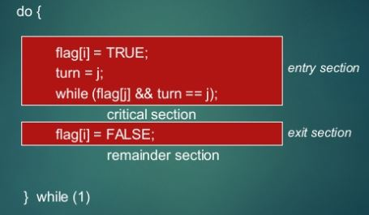
Solution to synchronization problem(Contd…)
Software Approach to synchronization problem(Peterson’s Solution):-
It is a two process solution.
We must assume that LOAD and STORE instructions are atomic and can not be interrupted in between.
The two processes will share two variables
(i)int turn :- is used to indicate that whose turn is there to enter in critical section.(ii)Boolean interested[2]:- is used to indicate whether a process is ready to enter in critical section the interested[i] = true {means Pi is ready}
Figure :4 [image source google ]

Slide 5
solution to synchronization problem(Cont.…)
Hardware Approach to synchronization problem(Peterson’s Solution):-
Exit section(process)
{
6. interested[process] == False;
}
CS
Entry section(process)
{
1. int other;
2. other = 1- process;
3. interested [ process] = TRUE;
4. turn = process
5. while (interested[other]==TRUE && turn == process);
}

Slide 6
solution to synchronization problem(Cont.…)
Analysis:-
(i) Mutual Exclusion is assured as only one process can access the critical section at any time.
(ii) Progress is also assured, as a process outside the critical section does not block other processes from entering the critical section.
(iii) Bounded Waiting is preserved as every process gets a fair chance.
Disadvantages:-
(i) It involves Busy waiting.
(ii) It is limited to 2 processes.

Slide 7
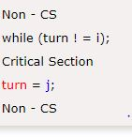
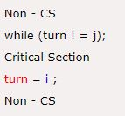
solution to synchronization problem(Cont.…)
Strict Alteration:-
Turn Variable or Strict Alternation Approach is the software mechanism implemented at user mode. It is a busy waiting solution which can be implemented only
for two processes. In this approach,
A turn variable is used which is actually
This approach can only be used for only two processes. In general, let the two processes be Pi and Pj. They share a variable called turn variable. The pseudo code of the program can be given as following.
Figure :6[image source google ]

Slide 8
PRODUCER AND CONSUMER PROBLEM
It is multi-process synchronization problem.
It is also known as bounded buffer problem.
This problem describes two processes producer and consumer, who share
common, fixed size buffer.
• Producer process will Produce some data item and put it into buffer.
• Consumer process will consume this data item (remove it from the buffer).
Condition for inconsistency:-
a) Producer must not try to produce any data item to buffer if buffer size is full.
b) Consumer must not try to consume any data item if buffer is empty.

Slide 9
PRODUCER AND CONSUMER PROBLEM
Solution for Producer:-
a) Producer either go to sleep or discard data if the buffer is full.
b) Once the consumer removes an item from the buffer, it notifies
the producer to put the data into buffer. (by using some synchronization tool)

Slide 10
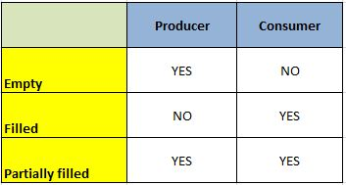
PRODUCER AND CONSUMER PROBLEM
Solution for Consumer:-
a) Consumer can go to sleep if the buffer is empty.
b) Once the producer puts data into buffer, it notifies the consumer
to remove (use) data item from buffer. (By using some synchronization tool)
Figure :7[image source google ]

Slide 11
SEMAPHORE
Semaphores are integer variables that are used to solve the critical section problem by using two atomic operations, wait() and signal() that are used for process synchronization.
The definitions of wait() and signal() are as follows
Wait:-The wait operation decrements the value of its argument S, if it is positive. If S is negative or zero, then no operation is performed.
wait(S)
{
while (S<=0);
S--;
}

Slide 12
SEMAPHORE
Signal:- The signal operation increments the value of its argument S.
signal(S)
{ S++;
}
Types of Semaphores:-
There are two main types of semaphores i.e. counting semaphores and binary semaphores. these are given as follows

Slide 13
Semaphore
Counting Semaphores:- These are integer value semaphores and have an unrestricted value domain. These semaphores are used to coordinate the resource access, where the semaphore count is the number of available resources. If the resources are added, semaphore count automatically incremented and if the resources are removed, the count I decremented.
Binary Semaphores:- The binary semaphores are like counting semaphores but their value is restricted to 0 and 1. The wait operation only works when the semaphore is 1 and the signal operation succeeds when semaphore is 0. It is sometimes easier to implement binary semaphores than counting semaphores.

Slide 14
Monitor
?
A more elevated level synchronization primitive.
A monitor is a bunch of techniques, variables, and information structures that are completely assembled in an exceptional sort of module or bundle.
Procedures may call the strategies in a monitor at whatever point they need to, however, they can't directly get to the monitor's interior data structures from methodology announced outside the monitor.
Monitor have a significant property for accomplishing common rejection: just one procedure can be dynamic in a monitor at any moment.

Slide 15
At the point when a procedure calls a monitor technique, the initial hardly any directions of the method will verify whether some other procedure is as of now dynamic inside the monitor .
Assuming this is the case, the calling procedure will be suspended until the different procedure has left the monitor. On the off chance that no different procedure is utilizing the monitor, the calling procedure may enter.

Slide 16
Producer consumer problem using monitor
The arrangement proposes condition factors, alongside two procedures on them, wait and signal.
At the point when a monitor method finds that it can't proceed (e.g., the maker finds the buffer full), it does a lookout for some condition variable, full.
This activity causes the calling procedure to block. It additionally permits another procedure that had been recently block from entering the screen to enter now.

Slide 17
Producer consumer problem using monitor
This different procedure the customer, can awaken its dozing accomplice by doing a sign on the condition variable that its accomplice is looking out for.
To abstain from having two dynamic procedures in the monitor simultaneously a sign explanation may show up just as the last proclamation in a monitor method.
On the off chance that a sign is done on a condition variable on which a few procedures are pausing, just one of them, controlled by the framework scheduler, is retrieve.

Slide 18
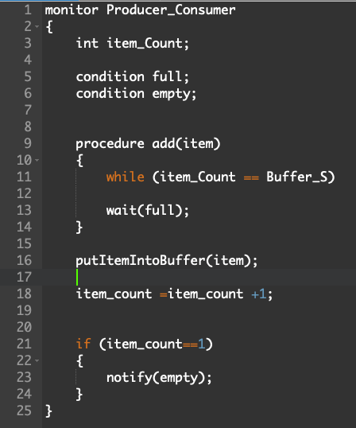
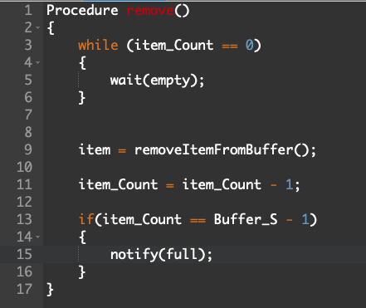
Producer consumer problem using monitor
Figure :9
Figure :8

